Slide 1

Introduction to MATLAB
CSE-214

Slide 2
What is Matlab?
Matlab is basically a high level language which has many specialized toolboxes for making things easier for us
Provide interactive environment for numerical computation, visualization and programming.
Developed by MathWorks

Slide 3
MATLAB- Matrix Laboratory
Typical Uses:
Mathematical Computation
Signal processing and Communications
Modeling, Simulation and Prototyping
Data analysis, exploration and visualization
Scientific and Engineering graphics
Application development, including graphical user interface building

Slide 4



What are we interested in?
MATLAB is too broad for our purposes in this course.
The features that we are going to require:
MATLAB
m-files
Command Line
mat-files
functions
Series of build in commands and math functions

Slide 5
MatLab
The MATLAB environment is command oriented somewhat like UNIX.
A prompt appears on the screen and a MATLAB statement can be entered.
When the statement appears.
<ENTER>
is executed,
key is pressed, the and another prompt
If a statement is terminated with a semicolon ( ;
), no results will be displayed.
Otherwise results will appear before the next
prompt.

Slide 6
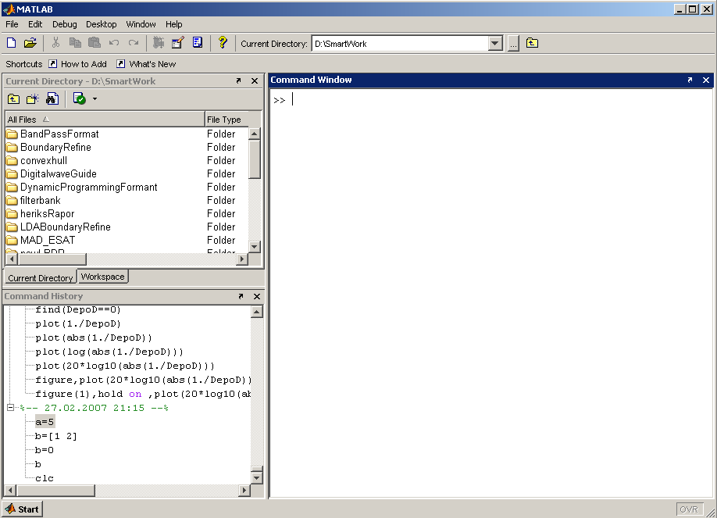
MatLab Screen
Command Window
type commands
Current Directory
View folders and m-files
Workspace
View program variables
Double click on a variable
to see it in the Array Editor
Command History
view past commands
save a whole session using diary

Slide 7
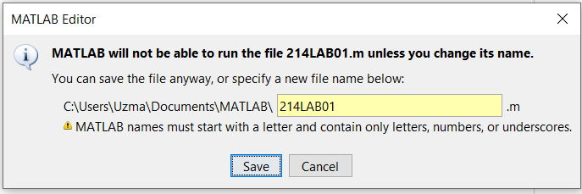
Variables and File name
Must start with a letter
May contain only letters, digits, and the underscore “_”
MatLab is case sensitive.
MATLAB variables are created with an assignment statement. The syntax of variable assignment is-
variable name = a value (or an expression)
- where expression is a combination of numerical values, mathematical operators, variables, and function calls

Slide 8
Variables
No need for types. i.e.,
int a; double b; float c;
All variables are created with double precision unless specified and they are matrices.
Example:
>>x=5;
>>x1=2;
After these statements, the variables are 1x1 matrices with double precision

Slide 9
To clear a variable
» who
Your variables are:
D ans rho
NRe mu v
» clear D
» who
Your variables are:
NRe ans mu rho v
»

Slide 10
>> x=[1 2 3]
x =
1 2
3
When defining variables, a space or comma separates elements on a row.
>> x=[1,2,3]
x =
1 2
>> x=[1
2
3
4];
>> x=[1;2;3;4]
3
A newline or semicolon forces a new row; these 2 statements are equivalent.
x =
1
2
3
4

Slide 11
Array, Matrix
a vector
x =
1 2 5 1
x = [1 2 3; 5 1 4; 3 2 -1]
x = [1 2 5 1]
a matrix
x =
 | 1 | 2 | 3
 | 5 | 1 | 4
 | 3 | 2 | -1
transpose
y = x’
y =
1
2
3
5 3
1 2
4 -1

Slide 12
Array, Matrix
■
t =1:10
t = start : end
t =
1 2 3 4 5 6 7 8 9 10
k =2:-0.5:-1 k = start : increment : end
■
k =
2 1.5 1 0.5 0 -0.5 -1
x = [1:4; 5:8]
x =
1
5
2
6
3
7
4
8

Slide 13
Generating Vectors from functions
zeros(M,N) MxN matrix of zeros
x = zeros(1,3)
x | = 0 | 0 | 0
ones(M,N) MxN matrix of ones x = ones(1,3) x = 1 1 1
rand(M,N) MxN matrix of uniformly distributed random _{x = rand(1,3)} numbers on (0,1) _{x =}
■
■
0.9501 0.2311 0.6068

Slide 14





Matrix Index
The matrix indices begin from 1 (not 0 (as in C))
The matrix indices must be positive integer
Given:
A(-2), A(0)
Error: ??? Subscript indices must either be real positive integers or logicals.
A(4,2)
Error: ??? Index exceeds matrix dimensions.

Slide 15
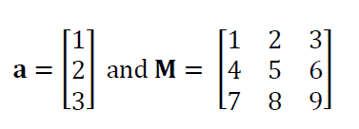
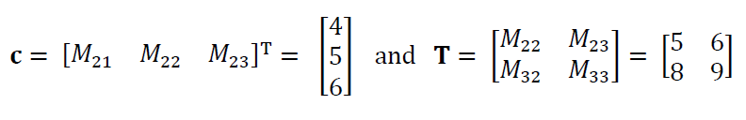
Element Access
c = M(2,:)';
T = M(2:3,2:3);
Notes:
Mention that the 2:3 means “the part of the row or column from element 2 to element 3”. Mention the notation 2:end also works. Mention other uses of the colon notation, e.g. that [1:5]=[1,2,3,4,5] and that [5:-1:1]=[5,4,3,2,1].

Slide 16
Concatenation of Matrices
x A | = = | [1 2], y = [ x y] |  |  | [4 | 5], | z=[ | 0 | 0]
 |  | 1 | 2 | 4 | 5
B = |  | [x | ; y]
 |  | 1 | 2
 |  | 4 | 5
C = [x y ;z]
Error:
??? Error using ==> vertcat CAT arguments dimensions are not consistent.

Slide 17
Operators (arithmetic)
+ addition
- subtraction
* multiplication
/ division
^ power
' Complex conjugate transpose

Slide 18
Built-in Functions
 | Trigonometric functions | sin, cos, tan, sin, acos, atan, sinh, cosh, tanh, asinh, acosh, atanh, csc, sec, cot, acsc, …
 | Exponential functions | exp, log, log10, sqrt
 | Complex functions | abs, angle, imag, real, conj
 | Rounding and Remainder functions | floor, ceil, round, mod, rem, sign

Slide 19
Mathematical Functions
» x=sqrt(2)/2
x =
0.7071
» y=sin(x)
y =
0.6496
»

Slide 20
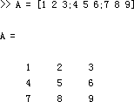
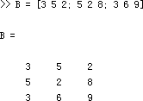
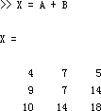
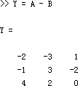
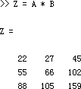
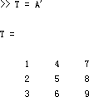
Matrices Operations
Given A and B:
Addition
Subtraction
Product
Transpose

Slide 21
Operators (Element by Element)
.* element-by-element multiplication
./ element-by-element division
.^ element-by-element power

Slide 22
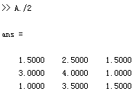
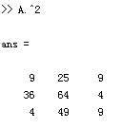
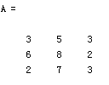
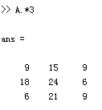
The use of “.” – “Element” Operation
Given A:
Divide each element of A by 2
Multiply each element of A by 3
Square each element of A

Slide 23
The use of “.” – “Element” Operation
A = [1 2 3; 5 1 4; 3 2 -1]
A =
1 2 3
5 1 4
3 2 -1
b = x .* y
b=
3 8 -3
c = x . / y
c=
0.33 0.5 -3
d = x .^2
d=
1 4 9
x = A(1,:)
x=
1 2 3
y = A(3 ,:)
y=
3 4 -1

Slide 24
Input and Output
>> x=input('please enter a number')
please enter a number 100
x =
100
fprintf('%d\t’,x)
100

Slide 25
Operators (relational, logical)
■ == Equal to
~= Not equal to
< Strictly smaller
> Strictly greater
<= Smaller than or equal to
>= Greater than equal to
& And operator
| Or operator

Slide 26
Flow Control
if
for
while
break
….

Slide 27
Control Structures
Some Dummy Examples
If Statement Syntax
if ((a>3) & (b==5))
Some Matlab Commands;
end
if (Condition_1)
Matlab Commands elseif (Condition_2)
Matlab Commands elseif (Condition_3)
Matlab Commands
else
Matlab Commands
end
if (a<3)
Some Matlab Commands;
elseif (b~=5)
Some Matlab Commands; end
if (a<3)
Some Matlab Commands;
else
Some Matlab Commands;
end

Slide 28
Control Structures
For loop syntax | Some Dummy Examples for i=1:100 Some Matlab Commands; end
for i=Index_Array Matlab Commands | for j=1:3:200 Some Matlab Commands; end
end | for m=13:-0.2:-21 Some Matlab Commands; end
 | for k=[0.1 0.3 -13 12 7 -9.3] Some Matlab Commands; end

Slide 29
Some Examples
>> for p=1:10
fprintf('%d\t',p)
end
1 2 3 4 5 6 7 8 9 10 >>
>> for p=1:2:10
fprintf('%d\t',p)
end
1 3 5 7 9 >>

Slide 30
Control Structures
While Loop Syntax
while (condition)
Matlab Commands end
Dummy Example
while ((a>3) & (b==5))
Some Matlab Commands;
end

Slide 31
Example x=ceil(10*rand(1,1));
y=input(‘Guess my number between 1 and 10:’); if(x==y)
‘you are right’ elseif(x>y)
‘No,my number is smaller’ else
‘No,my number is greater’ end

Slide 32
Another example: x=ceil(10*rand(1,1)); sum=0;
for y=1:x sum=sum+y; end
Practice:
Output the summation of each content of a matrix

Slide 33
M-Files
Script file: a collection of MATLAB commands
Function file: a definition file for one function

Slide 34
Script Files
Any valid sequence of MATLAB commands can be in the script files.
Variables defined/used in script files are global, i.e., they present in the workspace.

Slide 35
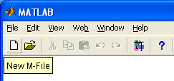
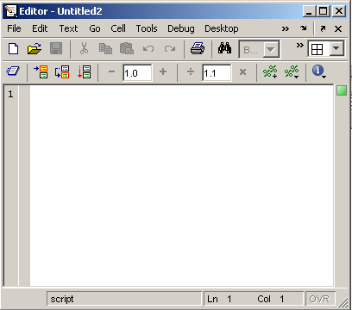
Use of M-File
Click to create
a new M-File
Extension “.m”
A text file containing script or function or program to run

Slide 36
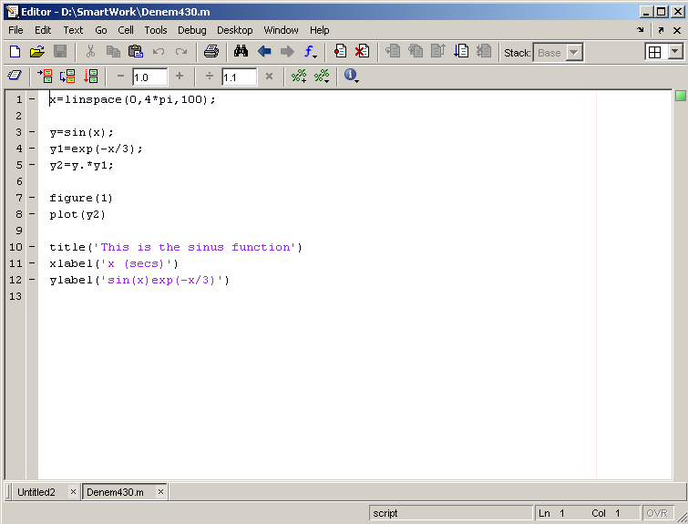
Use of M-File
Save file as Denem430.m
If you include “;” at the end of each statement, result will not be shown immediately

Slide 37
Writing User Defined Functions
Functions are m-files which can be executed by
specifying some inputs and supply some desired outputs.
The code telling the Matlab that an m-file is actually a function is
function out1=functionname(in1)
function out1=functionname(in1,in2,in3)
function [out1,out2]=functionname(in1,in2)
You should write this command at the beginning of the m-file and you should save the m-file with a file name same as the function name

Slide 38
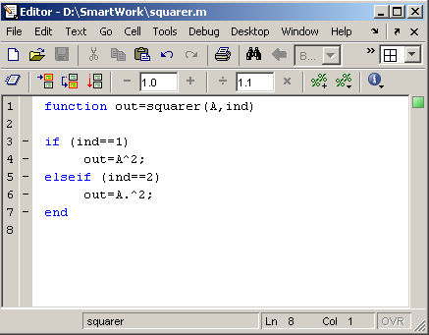
Writing User Defined Functions
Examples
Write a function : out=squarer (A, ind)
Which takes the square of the input matrix if the input indicator is equal to 1
And takes the element by element square of the input
matrix if the input indicator is equal to 2
Same Name

Slide 39
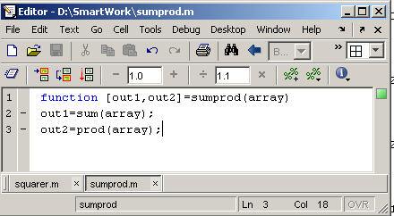
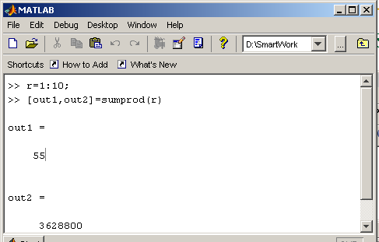
Writing User Defined Functions
Another function which takes an input array and returns the sum and product of its elements as outputs
The function sumprod(.) can be called from command window or an m-file as

Slide 40
Notes:
“%” is the neglect sign for Matlab (equaivalent of “//” in C). Anything after it on the same line is neglected by Matlab compiler.
Sometimes slowing down the execution is done deliberately for observation purposes. You can use the command “pause” for this purpose
pause %wait until any key
pause(3) %wait 3 seconds

Slide 41
Basic Task: Plot the function sin(x) between 0≤x≤4π
Create an x-array of 100 samples between 0 and 4π.
>>x=linspace(0,4*pi,100);
Calculate sin(.) of the x-array
1
0.8
>>y=sin(x);
0.6
0.4
0.2
Plot the y-array
0
-0.2
-0.4
>>plot(y)
-0.6
-0.8
-1
0
10
20
30
40
50
60
70
80
90
100

Slide 42
Plot the function e^{-x/3}sin(x) between 0≤x≤4π
Create an x-array of 100 samples between 0 and 4π.
>>x=linspace(0,4*pi,100);
Calculate sin(.) of the x-array
>>y=sin(x);
Calculate e^{-x/3} of the x-array
>>y1=exp(-x/3);
Multiply the arrays y and y1
>>y2=y*y1;

Slide 43
Plot the function e^{-x/3}sin(x) between 0≤x≤4π
Multiply the arrays y and y1 correctly
>>y2=y.*y1;
Plot the y2-array
>>plot(y2)
0.7
0.6
0.5
0.4
0.3
0.2
0.1
0
-0.1
-0.2
-0.3
0
10
20
30
40
50
60
70
80
90 100

Slide 44

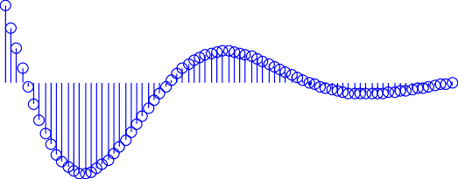
Display Facilities
0.7
0.6
plot(.)
0.5
0.4
Example:
>>x=linspace(0,4*pi,100);
>>y=sin(x);
>>plot(y)
>>plot(x,y)
0.3
0.2
0.1
0
-0.1
-0.2
-0.3
0
10
20
30
40
50
60
70
80
90 100
stem(.)
0.7
0.6
0.5
0.4
0.3
Example:
>>stem(y)
>>stem(x,y)
0.2
0.1
0
-0.1
-0.2
-0.3
0
10
20
30
40
50
60
70
80
90 100

Slide 45
Display Facilities
Setting Colors on Graph:
Code | Code
w | White
k | Black
b | Blue
r | Red
c | Cyan
g | Green
m | Magenta
y | Yellow
plot(x,y,'r')

Slide 46
Display Facilities
title(.)
>>title(‘This is the sinus function’)
This is the sinus function
1
xlabel(.)
0.8
0.6
>>xlabel(‘x (secs)’)
0.4
0.2
sin(x)
0
ylabel(.)
-0.2
-0.4
-0.6
>>ylabel(‘sin(x)’)
-0.8
-1
0
10
20
30
40 50 60
x (secs)
70
80
90 100

Slide 47
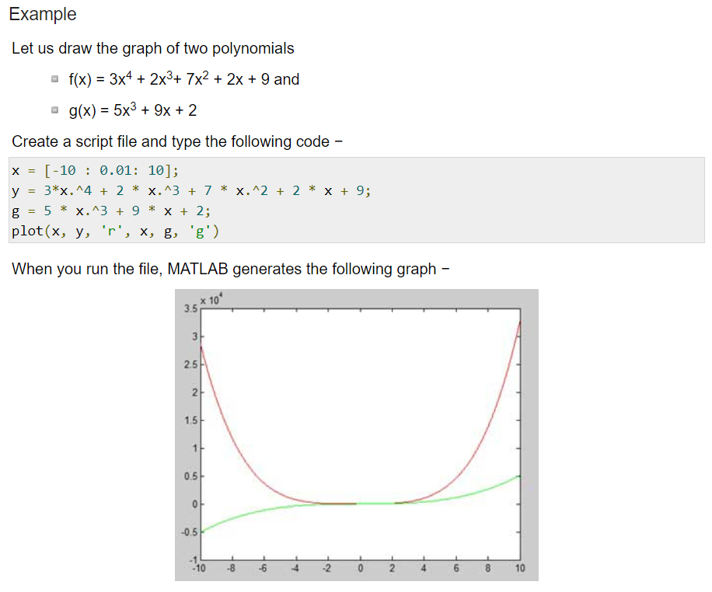

Slide 48
Useful Commands
The two commands used most by Matlab users are
>>help functionname
>>lookfor keyword

Slide 49
Some more Useful MATLAB commands
who List known variables
whos List known variables plus their size
help >> help sqrt Help on using sqrt
lookfor >> lookfor sqrt Search for keyword sqrt in m-files
what >> what a: List MATLAB files in a:
clear Clear all variables from work space
clear x y Clear variables x and y from work space
clc Clear the command window

Slide 50
Some more Useful MATLAB commands
type test Display test.m in command window
delete test Delete test.m
cd a: Change directory to a:
chdir a: Same as cd
pwd Show current directory

Slide 51
Thankyou

